Slide 1

Indeterminate Forms and L’Hôpital’s Rule

Slide 2
Objectives
At the end of the lesson, the student should be able to:
recognize limits that produce indeterminate forms.
apply L’Hôpital’s Rule to evaluate a limit.

Slide 3

It may happen that in the evaluation of the limit of an expression, substitution of the limit of the independent variable into the expression leads to a meaningless symbol such as
Expressions such as these whose limits cannot be determined by direct use of the theorems on limits are called indeterminate forms.
$$\frac{0}{0}, \frac{∞ }{∞} or 0∙∞$$

Slide 4
A very useful tool in the evaluation of indeterminate forms is the rule given below which was named after the mathematician Guillaume F. A. de L’Hôpital.

Slide 5
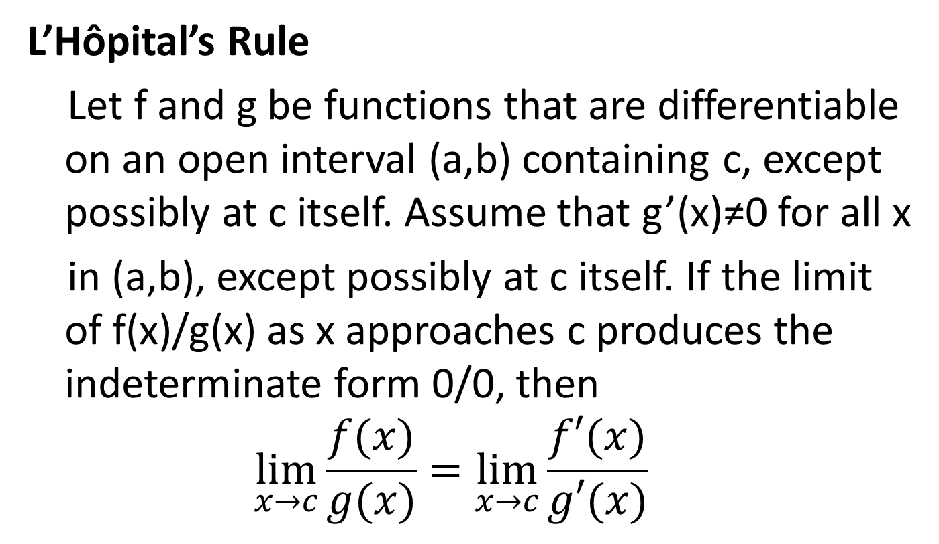
The Indeterminate Forms 0/0 and ∞/∞
L’Hôpital’s Rule
Let f and g be functions that are differentiable on an open interval (a,b) containing c, except possibly at c itself. Assume that g’(x)≠0 for all x
in (a,b), except possibly at c itself. If the limit of f(x)/g(x) as x approaches c produces the indeterminate form 0/0, then
$$\lim_{x→c}{\frac{f(x)}{g(x)}}=\lim_{x→c}{\frac{f′(x)}{g′(x)}}$$

Slide 6
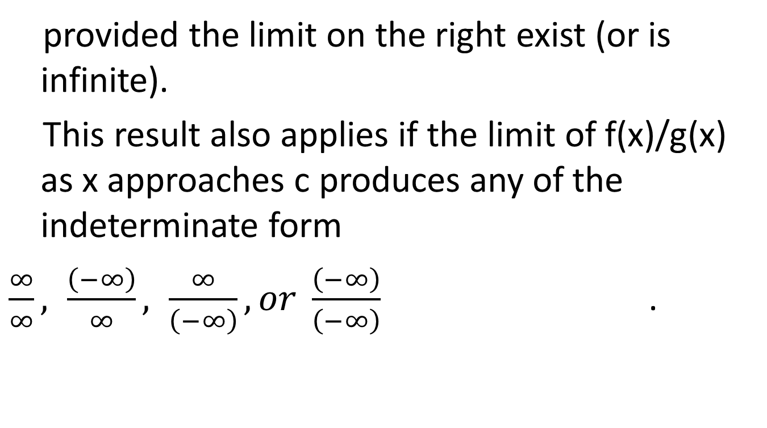
provided the limit on the right exist (or is infinite).
This result also applies if the limit of f(x)/g(x) as x approaches c produces any of the indeterminate form
$\frac{∞}{∞}, \frac{\left(−∞\right)}{∞}, \frac{∞}{\left(−∞\right)},or \frac{\left(−∞\right)}{\left(−∞\right)}$ .

Slide 7
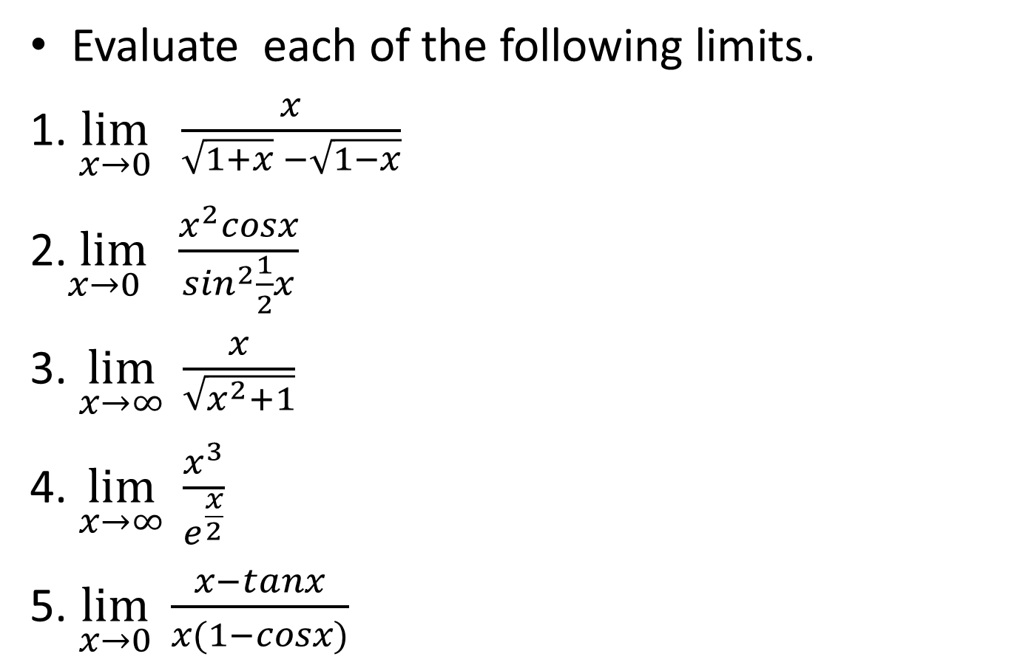
Example:

Slide 8
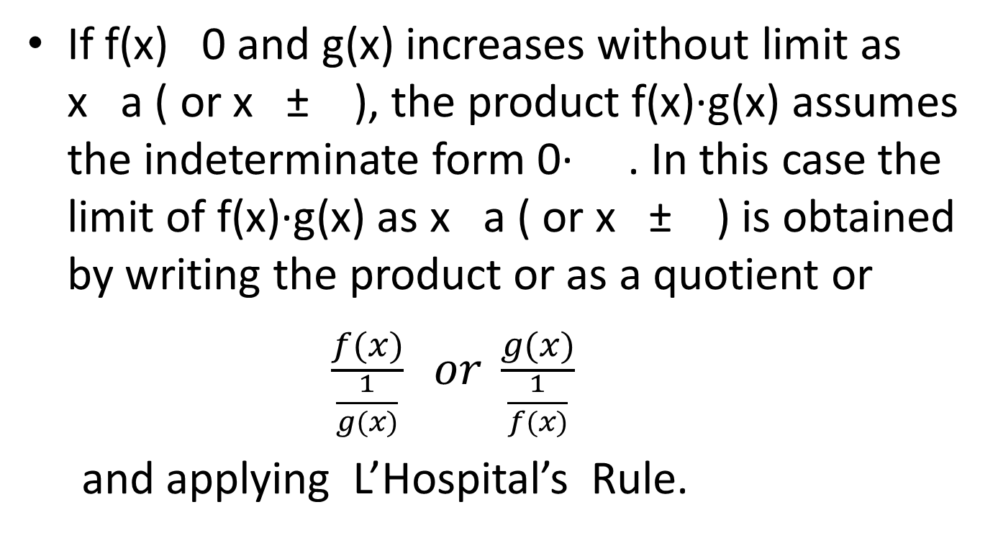

The indeterminate form $0∙∞$
If f(x) 0 and g(x) increases without limit as x a ( or x ± ), the product f(x)·g(x) assumes the indeterminate form 0· . In this case the limit of f(x)·g(x) as x a ( or x ± ) is obtained by writing the product or as a quotient or
$$\frac{f(x)}{\frac{1}{g(x)}} or \frac{g(x)}{\frac{1}{f(x)}}$$
and applying L’Hospital’s Rule.

Slide 9

Example:
$\lim_{x→0^{+}}{ \left(e^{x}−1\right)lnx}$
$\lim_{x→0}{cscx\sin^{−1}{x}}$
$\lim_{x→∞}{xsin\frac{3}{x}}$

Slide 10
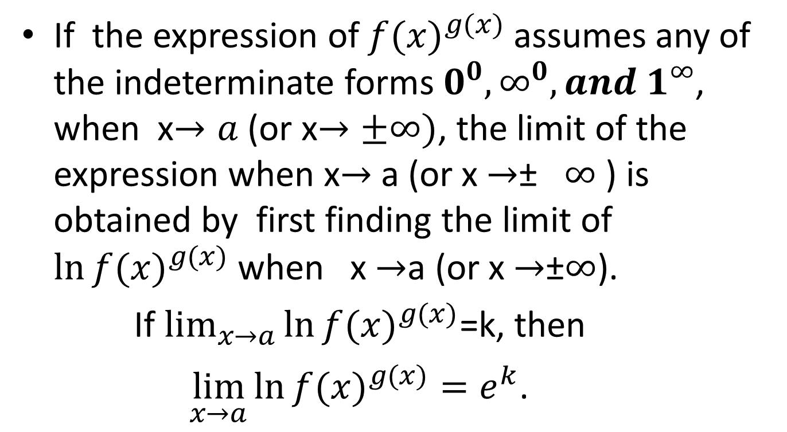

The Indeterminate Forms $$0^{0},∞^{0}, and 1^{∞}$$
If the expression of ${f(x)}^{g(x)}$ assumes any of the indeterminate forms $0^{0},∞^{0}, and 1^{∞}$, when x$→a$ (or x$→±∞)$, the limit of the expression when x$→$ a (or x $→$± $∞$ ) is obtained by first finding the limit of $\ln{{f(x)}^{g(x)}}$ when x $→$a (or x $→$±$∞$).
If $\lim_{x→a}{\ln{{f(x)}^{g(x)}}}$=k, then
$\lim_{x→a}{\ln{{f(x)}^{g(x)}=e^{k}}}$.

Slide 11

Example:
$\lim_{x→∞}{{\left(1+x^{2}e^{x}\right)}^{\frac{1}{x}}}$
$\lim_{x→0}{{ (sinx)}^{tanx}}$
$\lim_{x→0}{x^{x^{2}}}$
$\lim_{x→0}{{ (x+2^{x})}^{\frac{1}{x}}}$

Slide 12
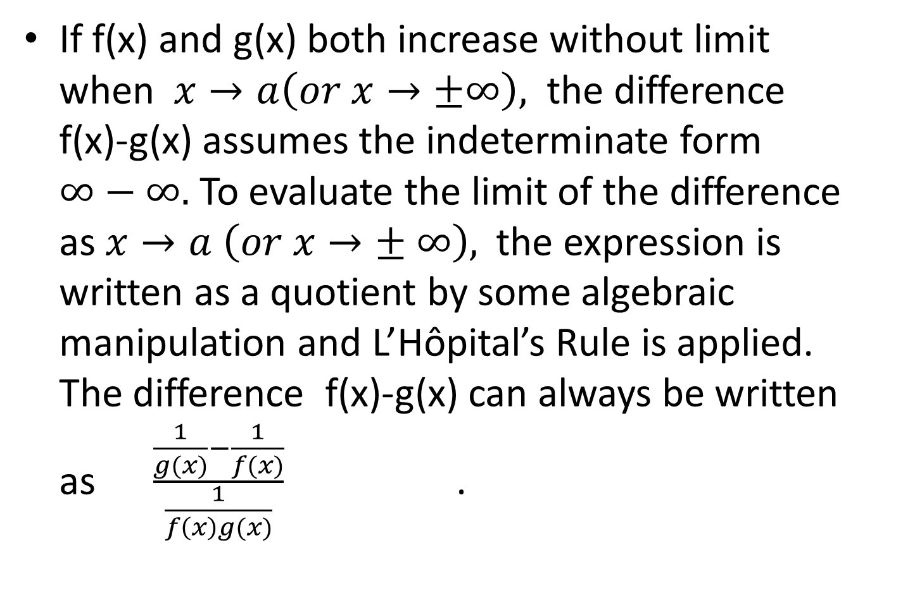

The Indeterminate Form $∞−∞$
If f(x) and g(x) both increase without limit when $x→a\left(or x→±∞\right),$ the difference f(x)-g(x) assumes the indeterminate form $∞−∞.$ To evaluate the limit of the difference as $x→a \left(or x→± ∞\right),$the expression is written as a quotient by some algebraic manipulation and L’Hôpital’s Rule is applied. The difference f(x)-g(x) can always be written as $\frac{\frac{1}{g(x)}−\frac{1}{f(x)}}{\frac{1}{f\left(x\right)g(x)}}$ .

Slide 13

Example:
$\lim_{x→2}\left[\frac{2}{ln⁡(x^{2}−3)} −\frac{x}{ln⁡(x^{2}−3)}\right]$
$\lim_{x→0}{\frac{1}{{\left(\tan^{−1}{x}\right)}^{2}}−\frac{1}{x^{2}}}$
$\lim_{x→0}{\frac{e^{2x}}{x}}− \frac{x+2}{e^{2x}−1}$
$\lim_{x→0}{\frac{2}{\sin^{2}x} − \frac{1}{1−cosx}}$

Slide 14
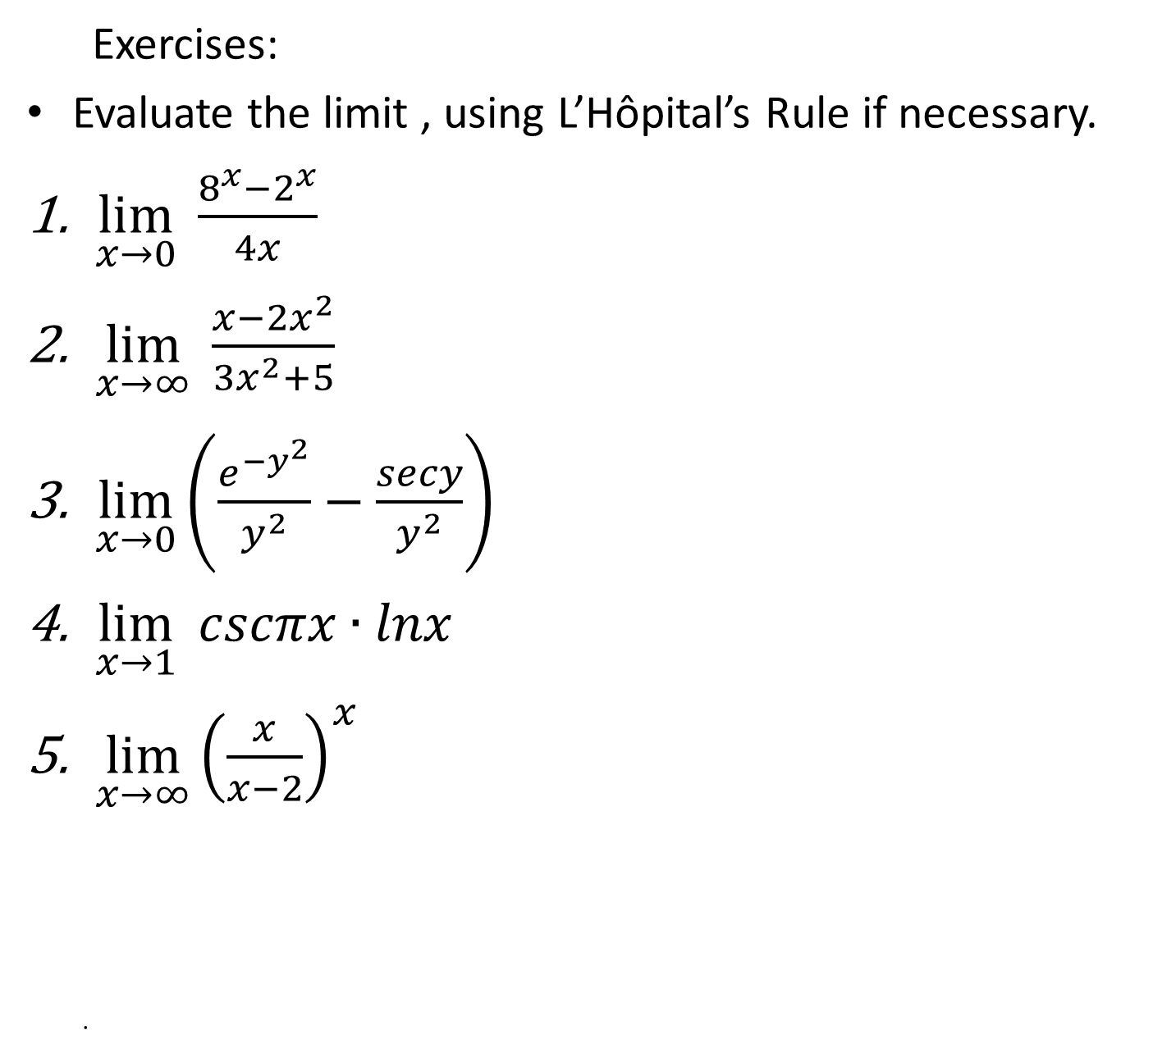
.
Exercises:
Evaluate the limit , using L’Hôpital’s Rule if necessary.
$\lim_{x→0}{\frac{8^{x}−2^{x}}{4x}}$
$\lim_{x→∞}{\frac{x−{2x}^{2}}{3x^{2}+5}}$
$\lim_{x→0}\left(\frac{e^{{−y}^{2}}}{y^{2}}−\frac{secy}{y^{2}}\right)$
$\lim_{x→1}{cscπx∙lnx}$
$\lim_{x→∞}{{\left(\frac{x}{x−2}\right)}^{x}}$
.

